Slide 1
Employee Attrition in Healthcare
Joseph Jaiyeola
DA 6813- Fall 2022

Slide 2
Background & Motivation of the Study
Employee attrition is the gradual but intentional loss of staff members within an organization.
The unprecedented covid-19 pandemic had been a burden to various sector of the economy, but most especially to the healthcare industry
The adverse effect of healthcare attrition include:-
Decrease in the quality of healthcare services and personnel
Loss of customers(patients) and decrease in profit.

Slide 3
Research Questions
What is the proportion of health care employees in attrition?
Are there any differentials in the attrition rate of healthcare employees?
What variables can be used to accurately predict employee attrition among health care workers?

Slide 4
Methodology
Data: Kaggle data Set, IBM Community
Descriptive Statistics
Tabulation
ANOVA & Chi-sq tests
Bar-graph and Histogram
Predictive Models:
Logistics Regression(GLM)
Decision Tree
Random Forest Model
Initial Sample Size: 1676 Observation, 35 variables
Data Cleaning:
Excluded: Daily Rate, Employee Count, Employee ID, Standard Hours, Hourly Rate, Monthly Rate and Daily Rate
Resampling: Sample size resampling due to imbalance data of the outcome variable

Slide 5

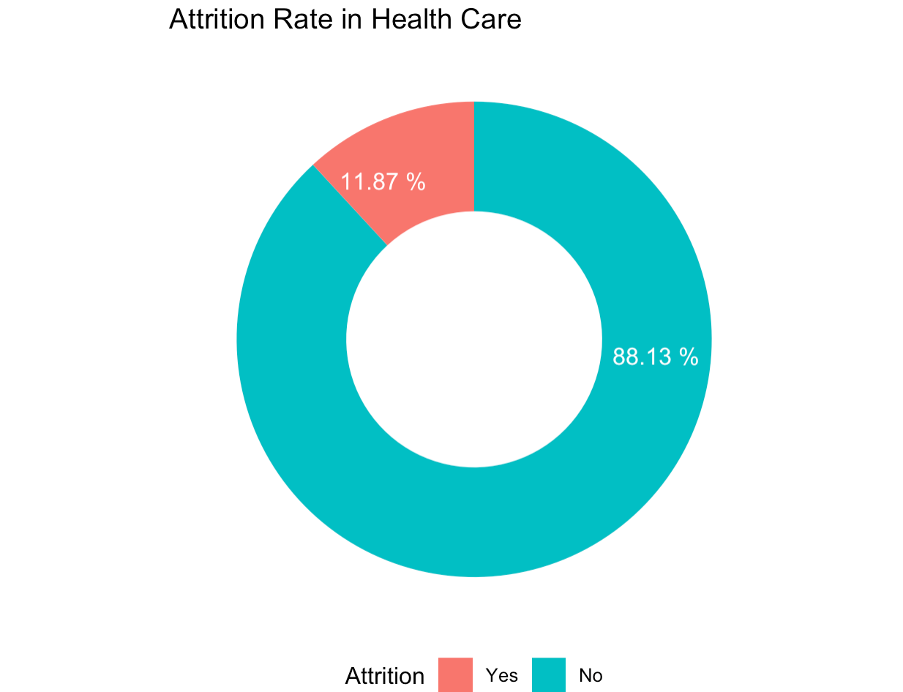
Percentage distribution of the Attrition Rate in HealthCare

Slide 6
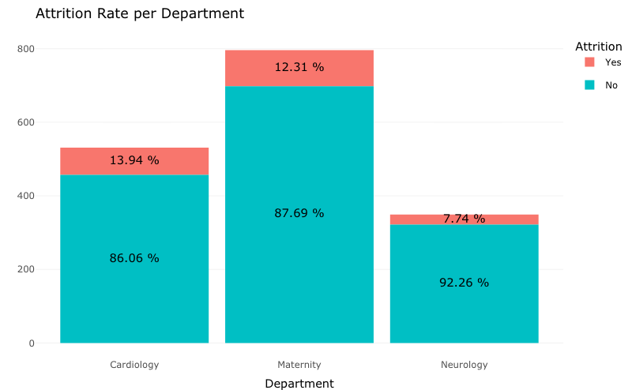
Attrition Rate by HealthCare Department

Slide 7
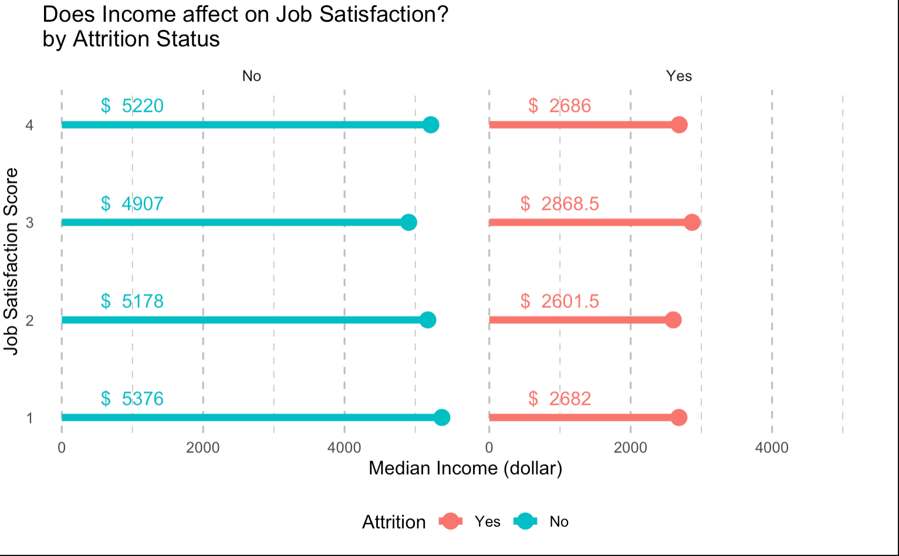
Monthly Income and Job Satisfaction by Attrition Status

Slide 8
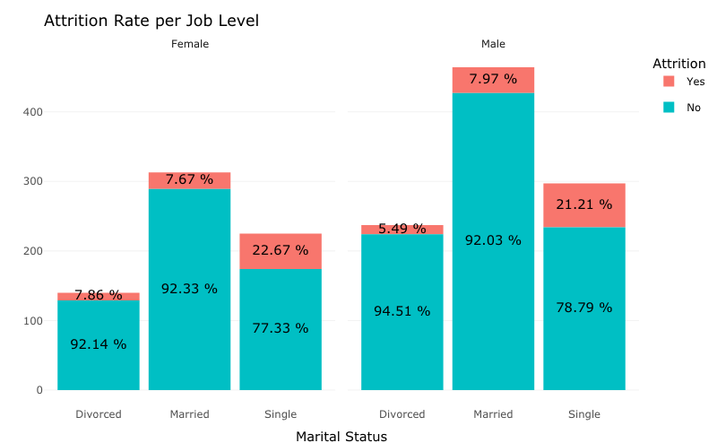
Gender and Marital Status by Attrition Status

Slide 9
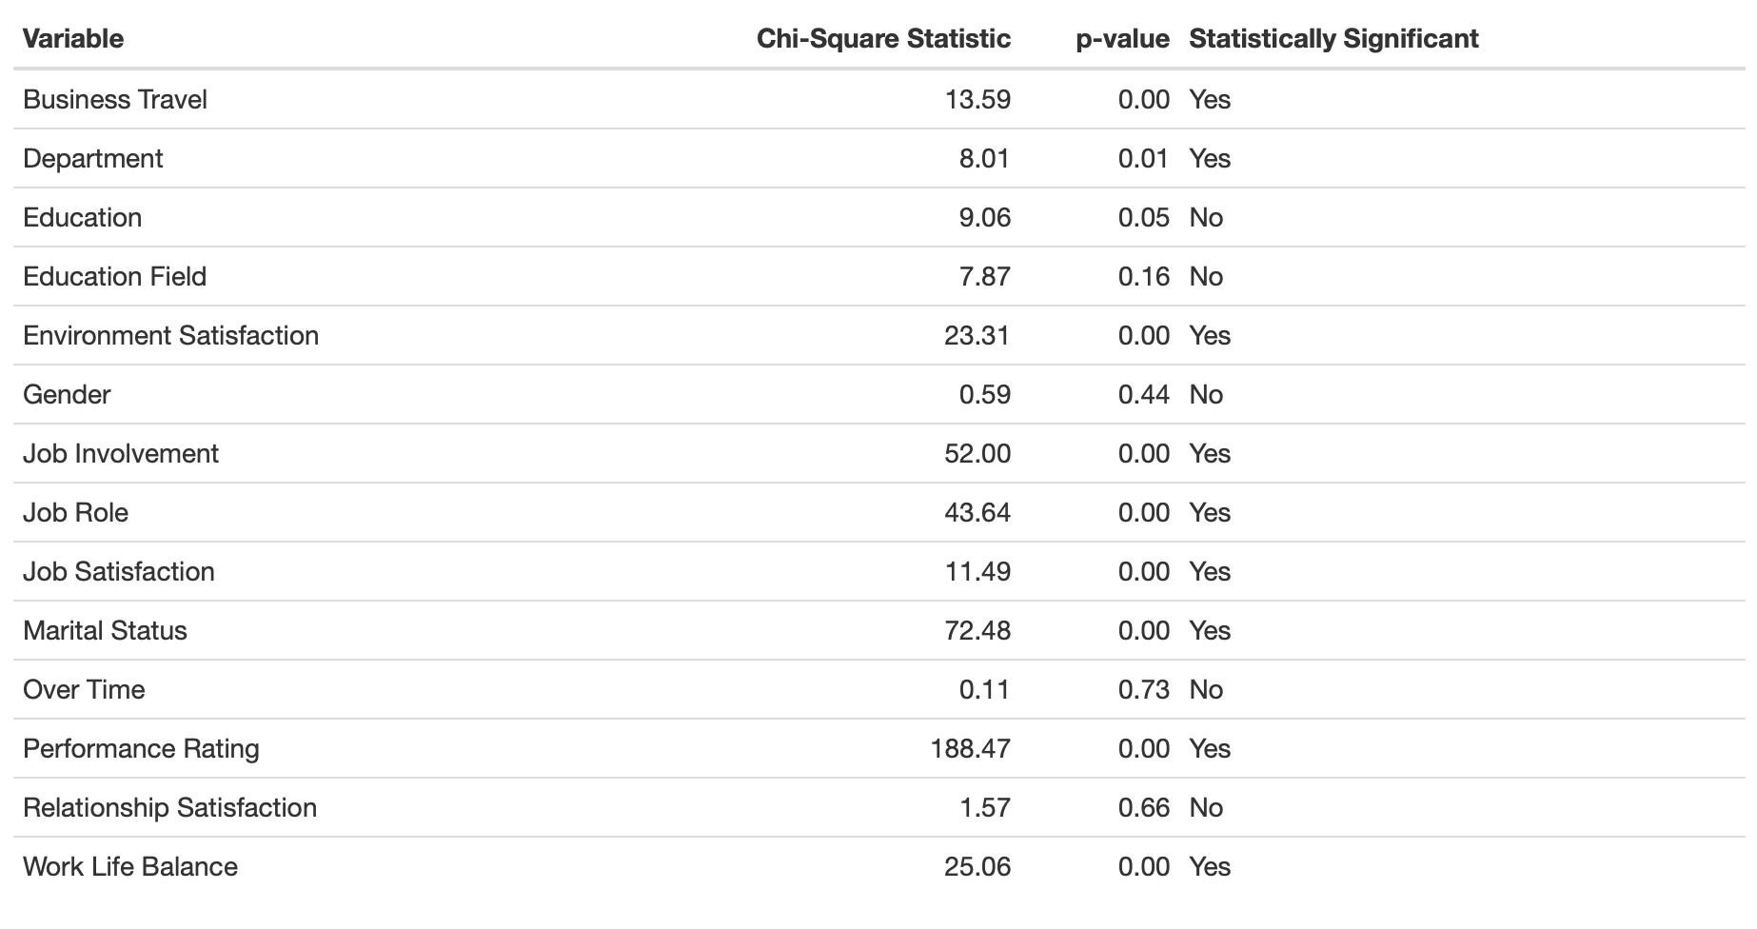
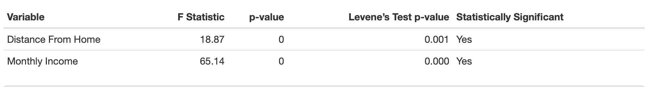
Chi-Square and ANOVA Test for Feature Selection

Slide 10
Model Accuracy, Sensitivity and Specificity Results
Model | Accuracy | Sensitivity | Specificity
Logistic Regression | 82.5 | 78.72 | 87.88
Decision Tree | 80.0 | 78.72 | 81.82
Random Forest | 87.5 | 85.11 | 90.91

Slide 11
Conclusion & Recommendation
Healthcare organizations with lesser compensation are more likely to experience higher attrition rate
Overtime, Years at Company, Total working years, and years in current roles are top predictors of employee attrition
There is a need to explore other data sources to determine the other factors associated with healthcare employee attrition

Slide 12
Thanks for listening
Questions?
Joseph.jaiyeola@utsa.edu
TW: @Josephjaiyeola1

